Slide 1


Project 1: Analysis Diabetes Disease Diagnosed for US Population Manuel Borrego / Orlando García / José Sierra / Gustavo Maldonado

Slide 2

Objetive:
Our Project is to discover the incidents of social demographics in diagnosed diabetes for population in US. We will analyze the relationship between gender, race-ethnicity, range of ages, educational levels, and related disease through the years, as the data admits.

Slide 3

Questions:
What is the proportion by ethnicity with diagnosed diabetes?
How is the disease behavior in range of ages to define if there is a correlation between them?
How is the gender distribution for diagnosed diabetes?
How are the impacts in the educational and income levels in relationship with diagnosed diabetes?
Data:
Based on population in US according to the Center for Disease Control and Prevention data source.

Slide 4
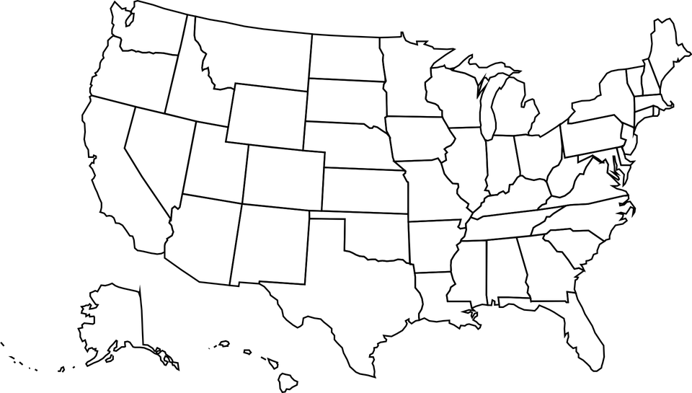

FUNDAMENTALS
Diabetes
Type 1 & 2
Risk Factors
Diabetes is a chronic (long-lasting) health condition that affects how your body turns food into energy.
Is a group of metabolic disorders characterized by a high blood sugar level over a prolonged period of time. Symptoms often include frequent urination, increased thirst and increased appetite.
Type 1 diabetes is thought to be caused by an autoimmune reaction (the body attacks itself by mistake) that stops your body from making insulin(5-10% of the people).
Type 2 diabetes, your body doesn’t use insulin well and can’t keep blood sugar at normal levels (90-95% of people).
Obesity or being overweight.
Ethnic background.
Sedentary lifestyle.
Family history.
Age.
Diabetes in numbers:
Diabetes is the seventh leading cause of death in the United States. 34.2 million US adults have diabetes, and 1 in 5 of them don’t know they have it.
In the last 20 years, the number of adults diagnosed with diabetes has more than doubled. Diabetes is the No. 1 cause of kidney failure, lower-limb amputations, and adult blindness.

Slide 5
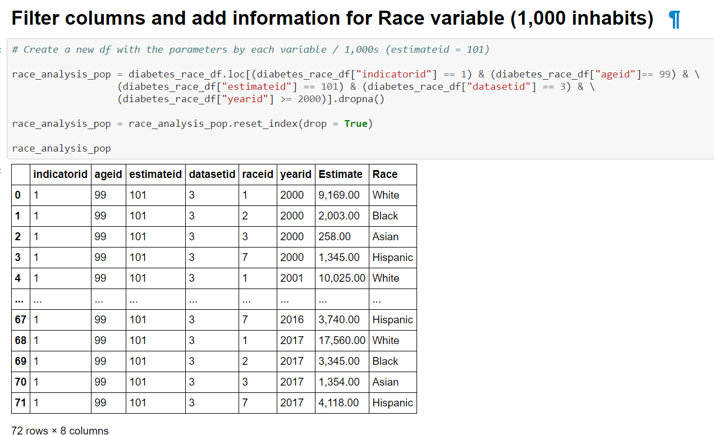
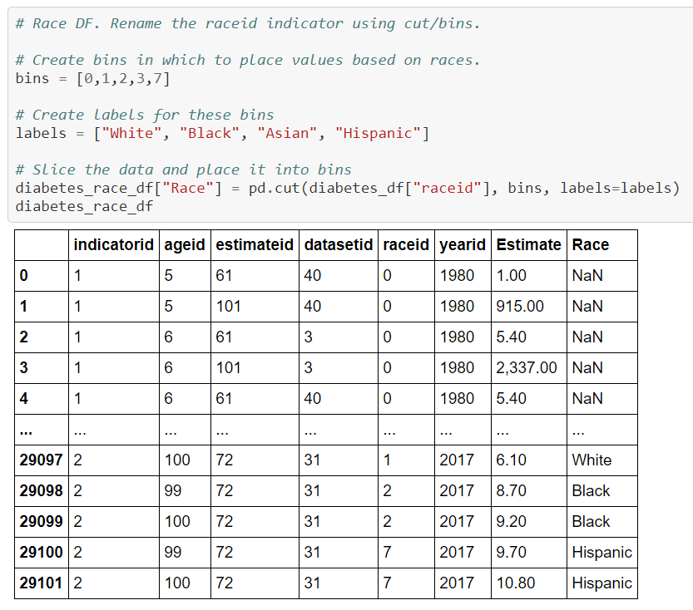
Main Variables:
Diagnosed Diabetes.
Percentage change & 1,000 inhabitants.
Crude data.
Adult aged 18+ Years.
Clean up Process:
CSV reader.
Declare main variables.
Cut & Bins to define social demographic variable.
Loc & dropna according to the variables.
Get pivot table to summarize data.
Plot the results (1,000s & percentage change).

Slide 6
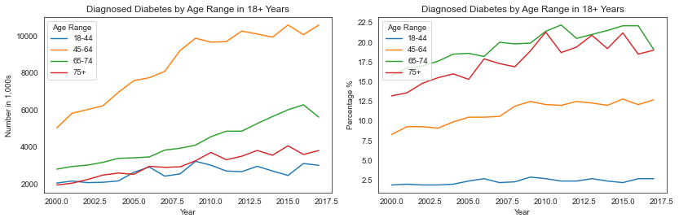
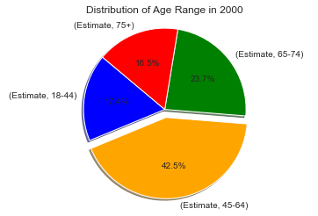
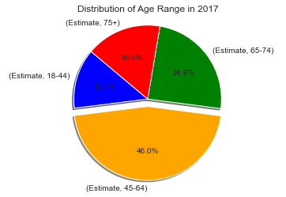
I. Age
II. Race
III. Education
IV. Gender
Trend Analysis by 1,000s & percentage change.
In total numbers, there is an ascending pattern for all Age Ranges. 45-64 group shows the higher population diagnosed in all years.
In percentages, there is an ascending pattern for all Age Ranges with exception of 0-44 group which shows a steadier line.
65-74 group has the higher percentual increase close to +75 group. +75 will go over 65-74.
Distribution 2000 & 2017.
In the year of 2000, 45-64 Age Range group shows a higher population diagnosed and also in 2017 with more than 40%.
18-44 Age Range group drops more than 4% compared with 2000 which increases in 45-64 group.

Slide 7
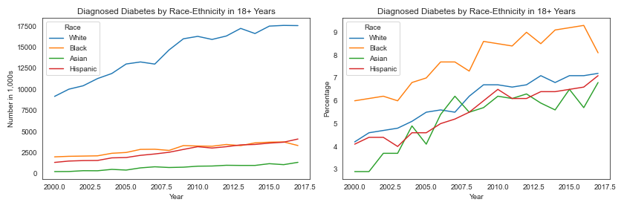
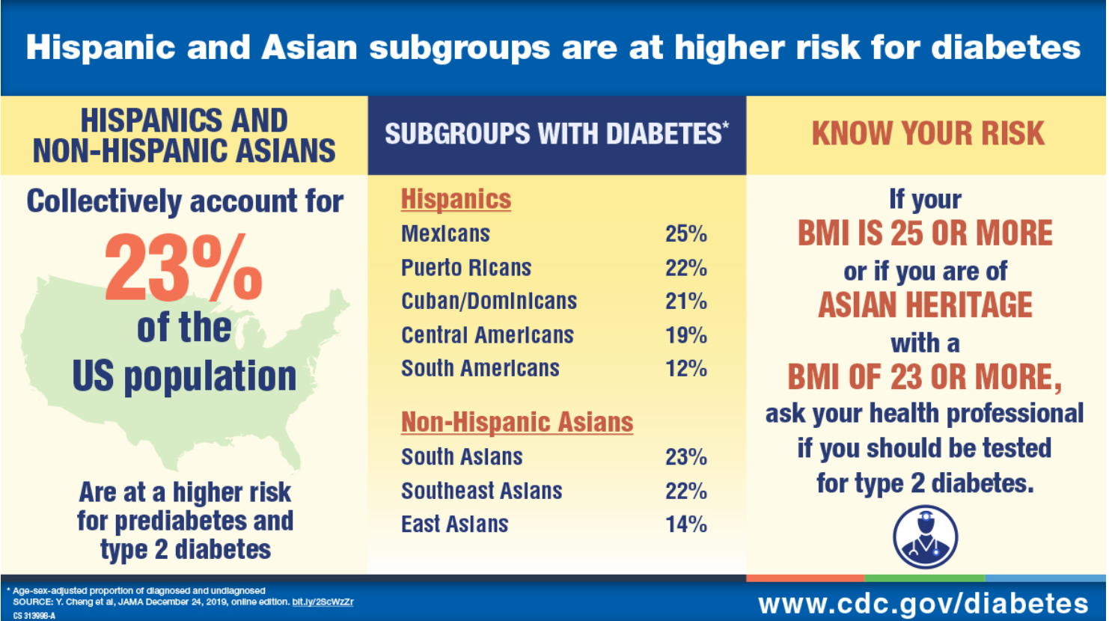
I. Age
II. Race
III. Education
IV. Gender
Trend Analysis by 1,000s & percentage change.
In total numbers, the White race has the higher level of diagnosed diabetes through the years.
In percentages, is interesting to observe how Black race has the higher increase proportions vs other races.
Center for Disease Control recommendations by race.
The race variable has been a key factor in a cosmopolitan country as US, that is how they tend to develop special programs to keep control and reduce the impact. Some examples:

Slide 8
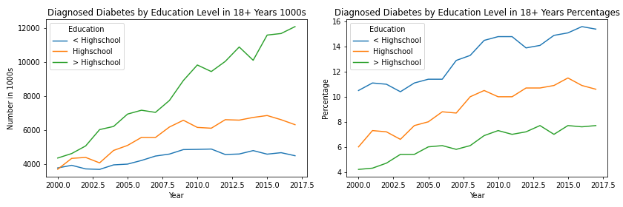
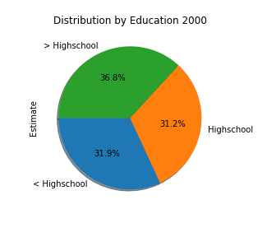
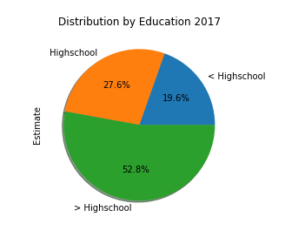
I. Age
II. Race
III. Education
IV. Gender
Trend Analysis by 1,000s & percentage change.
In total numbers, for High School levels, Basic Education cases don´t grow as much as Superior levels of education.
In percentages, from year to year the more advanced percentage growth is for Basic Education, but approximately they all keep growing the same.
Distribution 2000 & 2017.
In the year of 2017, superior to high school levels have more than half of the cases of Diabetes.

Slide 9
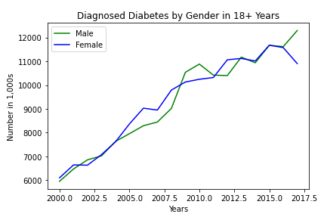
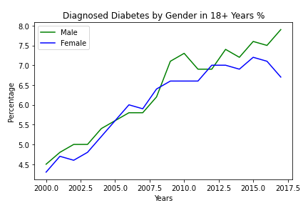
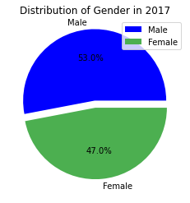
I. Age
II. Race
III. Education
IV. Gender
Trend Analysis by 1,000s & percentage change. Since the year 2000 there has been an increase of 3.4% diagnosed diabetes cases representing 6,343 new cases for Male and 2.4% which are 4,805 new cases for Female.
Distribution in 2017. In the year of 2017, the Diabetes population by Gender was 53% for Male and 47% for Female.

Slide 10

Conclusions
The probability to get diagnosed diabetes increases from 45 years old. It´s very important to avoid risks factors and improve general health in previous years.
The white ethnicity has the higher level of diabetes. The increase by race has been a key factor to develop programs to reduce the incidents in asian & hispanic people, which have a predisposition by their genetics & feeding habits.
Higher education level represents the large group with diagnosed diabetes. As the person works more time in the office, habits derivate often to sedentarism and not good health lifestyle balance (fast food – not exercise).
Even though the increase in all education groups is considerable, the higher education level remains as the largest group.
The risk of developing diabetes is higher within the Male population than the Female population in the U.S. There are different reasons why man are more susceptible than woman to the develop diabetes, per example: indolence and obesity.

Slide 11
REFERENCE
Centers for Disease Control & Prevention: https://open.cdc.gov/apis.html
NCD Risk Factor Collaboration: https://ncdrisc.org/data-downloads-diabetes.html
World Health Organization (WHO/OMS): https://www.who.int/es/news-room/fact-sheets/detail/diabetes
Analysis on Diabetes in India: https://www.kaggle.com/ravichaubey1506/univariate-statistical-analysis-on-diabetes
Diabetes Statistic Report: https://www.diabetesresearch.org/file/national-diabetes-statistics-report-2020.pdf
National Library of Medicine: https://pubmed.ncbi.nlm.nih.gov/11206408/
Diabetes Article Collection: https://www.elsevier.com/health/medicine/journals/diabetes-article-collection
Diabetes Research Institute Foundation: https://www.diabetesresearch.org/what-is-diabetes

Slide 12
Thank you!

